Slide 1
Estimation of energy performance of residential buildings using statistical machine learning tools
Tania Zakowski

Slide 2
Introduction
In the context of housing situation as a worldwide struggle for populations, many softwares dedicated to architectures are implementing new functionalities to calculate energy efficiency at different levels.
Based on a simulated dataset for research papers, today we will have a look at models to predict energy consumptions from buildings characteristics to keep temperatures in a range acceptable for people use.

Slide 3
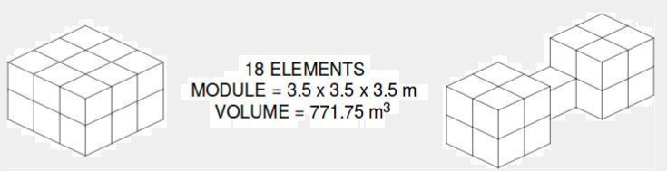
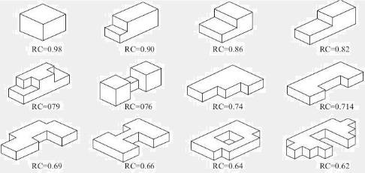

Dataset presentation
12 building forms where each building form is composed of 18 elements (elementary cubes)

Slide 4
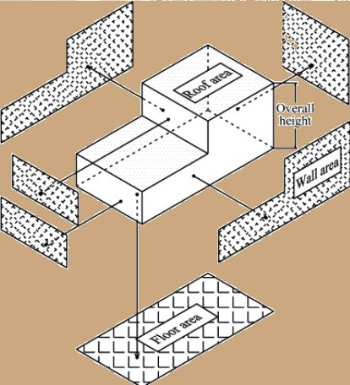

Dataset presentation
X1 | Relative Compactness | Continuous
X2 | Surface Area | Continuous
X3 | Wall Area | Continuous
X4 | Roof Area | Continuous
X5 | Overall Height | Continuous
X6 | Orientation | Integer
X7 | Glazing Area | Continuous
X8 | Glazing Area Distribution | Integer
Y1 | Heating Load | Continuous
Y2 | Cooling Load | Continuous

Slide 5
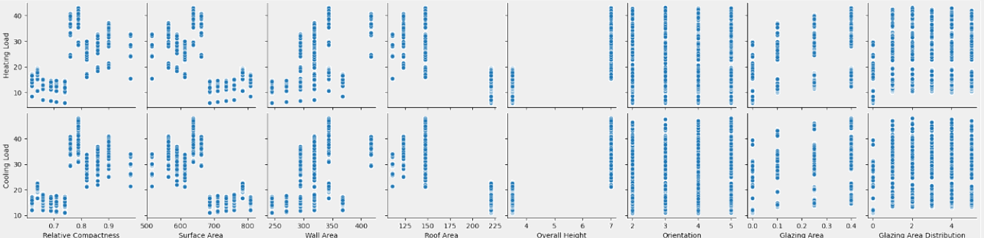
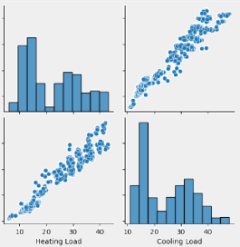
Features and targets correlations
Targets: 2 measures of energy required to keep buildings in tolerable range for human occupation

Slide 6
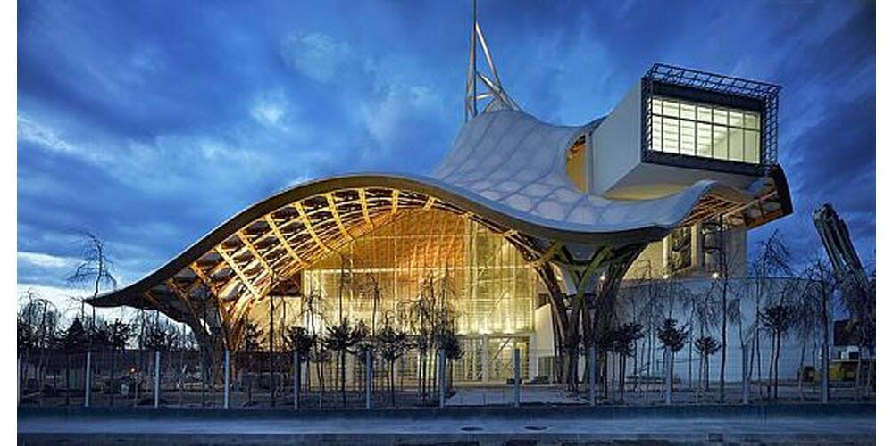
Apparté

Slide 7
Features and targets correlations
Targets

Slide 8
Models performed
How:
-regressions models
-all features kept, transformed with minmax scaler
-1 model per target (i.e. predictions of heating and cooling load separately)
What:
-KNN: doesn’t depend on data normality
-Random Forest: ensemble model handling collinearity in features
-Grid Search on Random Forests : good for small datasets and few features

Slide 9
Models performance
Heating Loads
Cooling Loads
R2 KNN1 | 0.915367
Mean Squared Error KNN1 | 9.345755
R2 RF1 | 0.996981
Mean Squared Error RF1 | 0.333355
R2 best RF1 | 0.996753
Mean Squared Error best RF1 | 0.358593
R2 KNN2 | 0.891359
Mean Squared Error KNN2 | 18.506228
R2 RF2 | 0.965682
Mean Squared Error RF2 | 3.227811
R2 best RF2 | 0.958244
Mean Squared Error best RF2 | 3.9274

Slide 10
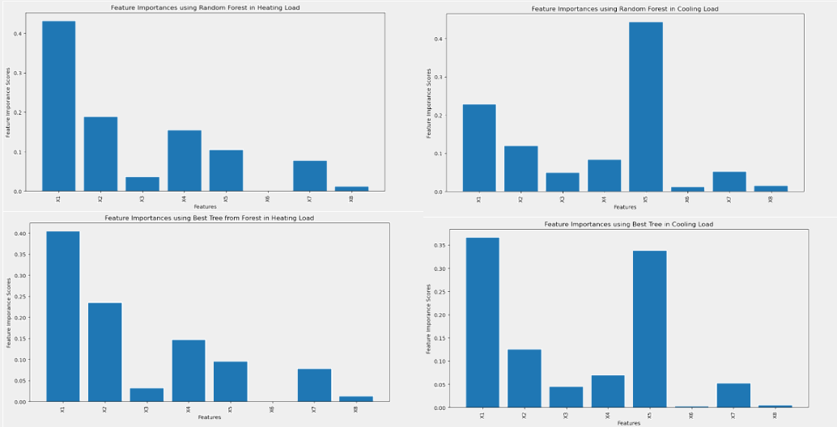
Features weighed in tree based models
X1 | X2 | X3 | X4 | X5 | X6 | X7 | X8
Relative Compactness | Surface Area | Wall Area | Roof Area | Overall Height | Orientation | Glazing Area | Glazing Area Distribution

Slide 11
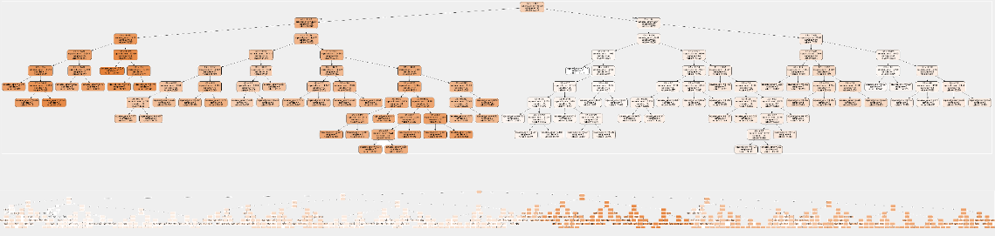
Best regression trees
Cooling Load
Heating Load

Slide 12
Models Interpretations
-R2 increased with complexity of the models and hyperfeatures tunning, as expected.
-Simple KNN regressions reached R2 app. 0,9 for both heating load and cooling load predictions.
-Random Forest model used for heating load predictions is overfitted, even before hyperparameters tuning.
-Models predicting cooling load appear less likely to be overfitted, particularly RF without hyperparameters tuning.

Slide 13
Conclusion
-Due to the nature of the features, simple linear models are not adapted despite most variables behind hypothetically continuous ( cf overall height, actually reflects the number of floors).
-Good to have models based on features related to buildings characteristics and environment as complement to energy efficiency calculation , but hidden correlation need to be considered ( cf relative compactness).
-Models are very dependant of geographical situation, that need to be considered to draw conclusions.

Slide 14
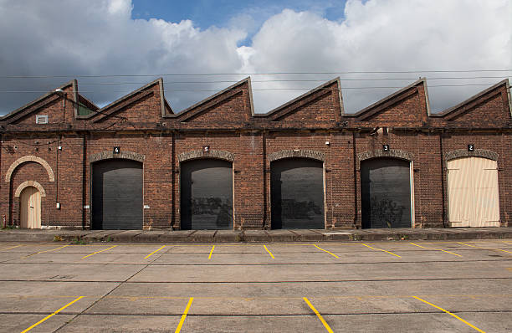
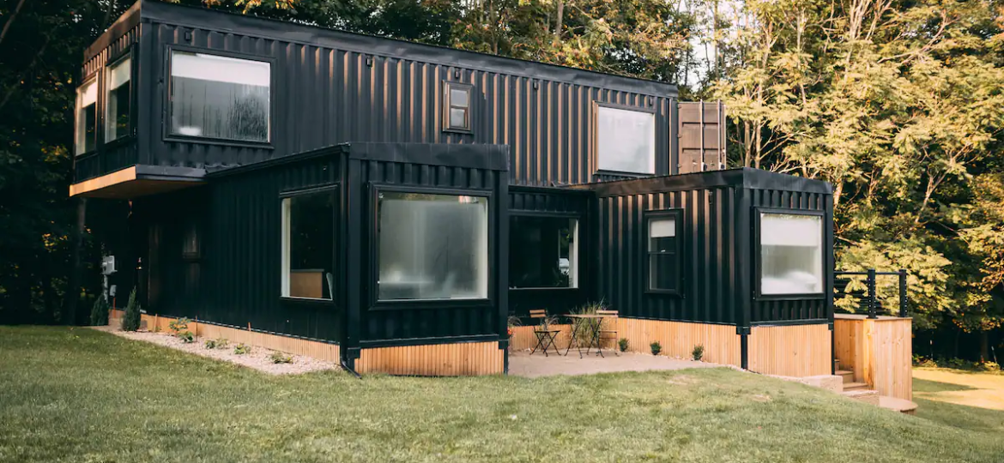
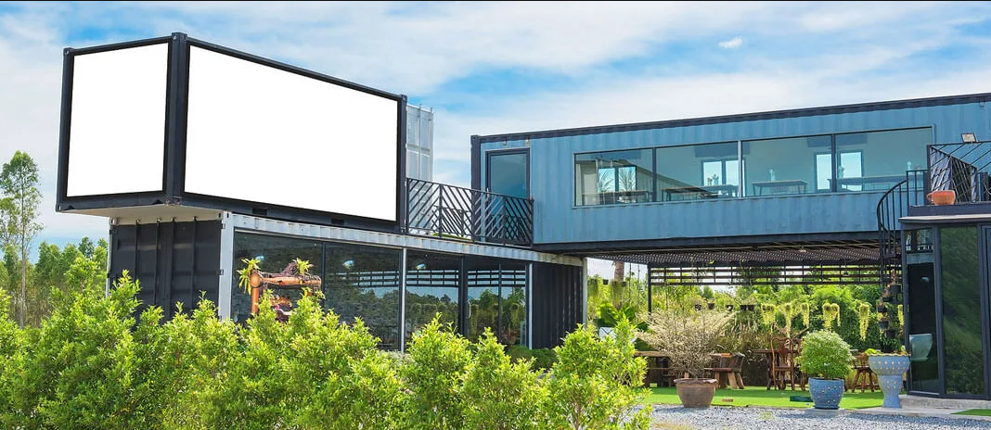
Main potential applications
Old Infrastructures renovation
Cargotecture: New houses using containers

Slide 15
THANK YOU
Tania Zakowski

